Slide 1


Connectedness in the Movie Industry
HNRS 304: Networks in the Info Age
Final Presentation by Cameron J. Calv

Slide 2
Goal
To identify the interconnectedness of various movie franchises

Slide 3
Method
Scrape cast list information from IMDB for all entries in a particular keyword search (E.g. All movies, shows, etc. listed under ‘Harry Potter’)
Only the featured cast list on the front page of the entry is considered to avoid an arbitrarily large number of nodes
Plot a network graph such that each node is a performer and each connection is a flick that two nodes (performers) have starred in together
Determine characteristics of the network that showcase interconnectedness

Slide 4
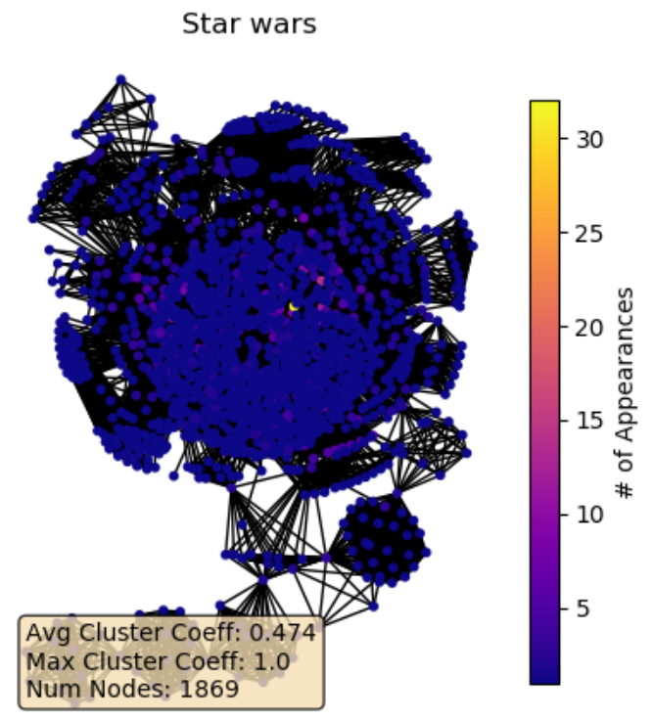
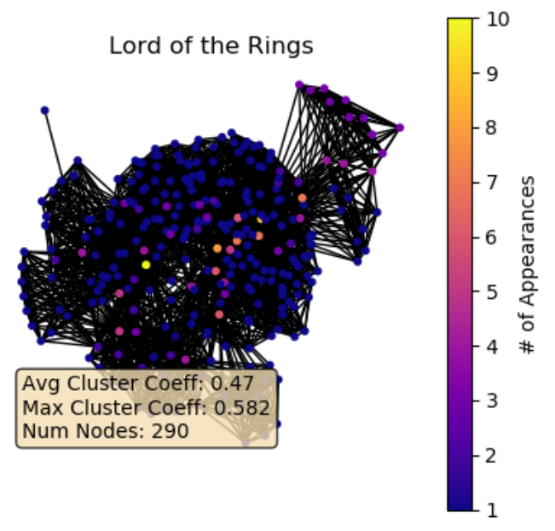
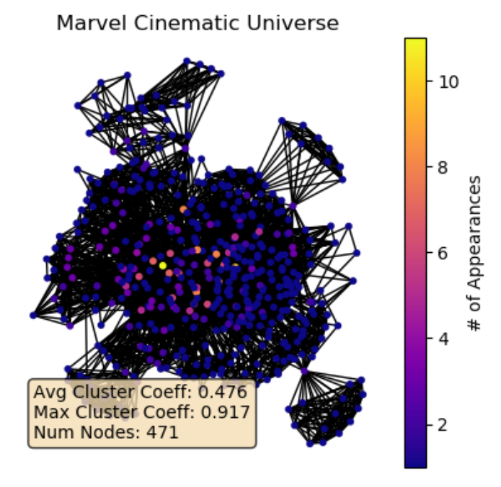
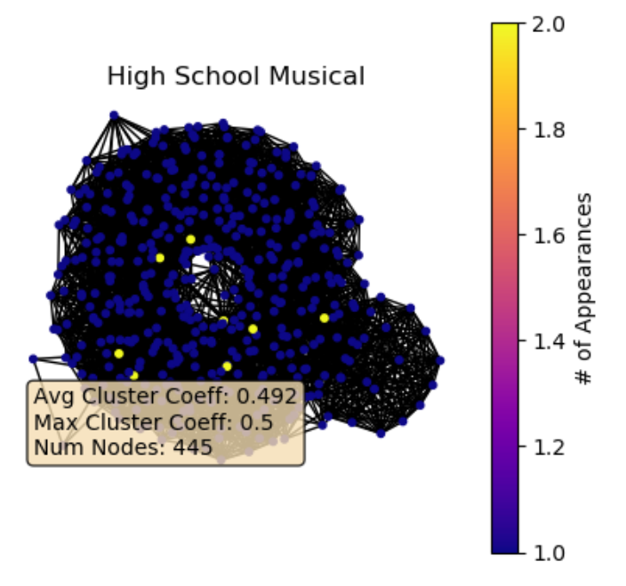
Preliminary Results
Marvel Cinematic Universe
High School Musical

